Slide 1





Assessing talent for future leadership roles
Liz Huckerby and Kay Sahdev

Slide 2




Presentation Overview
Assessing potential talent for the UN’s and UNDP’s most important leadership roles:
  Resident Coordinators/Representatives (RC/RR)
  Country Directors (CDs)
  Deputy Resident Representatives (DRRs)
  Deputy Country Directors (DCDs)
Candidate pools - how do they work?
  A closer look at the role of the RC/RR & the RC Assessment
Our journey to achieving gender parity and diversity
Do assessment centres increase accuracy in hiring decisions?
  Internal Study: Performance Appraisals & Assessment Centres
2

Slide 3
Assessment & Career Pathways
The corporate assessment process includes separate assessments for the RC/RR, CD and DRR/DCD role.
DRR/DCD Assessment
Possible Outcomes
RC Assessment
Possible Outcomes
Ready
Not Ready
Recommended
‘Recommended’ also eligible for CD posts
Ready
Not Ready
Not Recommended
Possible Outcomes
CD Assessment
Assessments
UNDP Career Pathway
DRR/DCD Assessment: Ready
DCD-P in small CO
RC Assessment: Recommended
RC/RR in Country X
Regional Prgm Advisor in RBx
CD Assessment: Ready
DRR-P/O in large CO
CD in large CO
CD in medium CO
2

Slide 4
Succession Planning: Selection Principles
Selection decisions are made on the basis of…
Service
Gender & Diversity
Spouse Employment
Performance
Learning
Potential
PMD Rating
Years of Service
Mobility, Hardship & Crisis experience
Guiding Principles
Competence
Contextual fit
Diversity
Strategic view
Inter-regional challenges

Slide 5
The Role of the RC/RR
Critical Elements
  Designated representative of the SG
  Convener of heads of all UN agencies in country
  Facilitator of UN agencies’ operational activities in country to ensure alignment with national plans and improve the overall contribution of the UN
  Coordination of all activities for development
  Accountable for UNDP programme and development results

Slide 6
Competencies for the RC/RR Role
Domain | Competencies
Managing Complexity | Analysis and Decision-Making Strategic and Political Thinking
Impact and Drive | Advocacy and Influence Resilience Principles, Values and Ethics
Delivering Results | Planning and Organising Drive for Results and Accountability
Leading and Engaging | Leading and Managing People Engaging and Nurturing Partners/ Stakeholders

Slide 7













Competency Definitions
Managing Complexity
The Resident Coordinator analyzes complex information identifying key issues, patterns and linkages.
Delivering Results
The Resident Coordinator sets clearly defined and challenging objectives.
Drive for Results & Accountability
Sets and maintains high standards for the work of self and others and drives an organizational culture focused on results.
Analysis & Decision-Making
Takes clear, well thought
out and timely decisions.
Strategic & Political Thinking Considers a broad range of issues, assesses the political environment.
Planning & Organizing
Takes action steps and identifies and mobilizes the required resources to accomplish objectives.
Leading & Engaging
The Resident Coordinator mobilizes others to respond to immediate and long term needs.
Impact & Drive
The Resident Coordinator influences opportunistically promoting the values and principles of the UN System.
Leading & Managing People
Develops shared purpose, provides clear direction.
Engaging & Nurturing Partners & Stakeholders
Identifies key partners and stakeholders to engage to accomplish work, building trust, rapport and understanding.
Advocacy & Influence
Consistently delivers impactful messages that are accurate, clear and concise.
Resilience
Works productively in a high pressure environment keeping emotions under control.
Values & Ethics
Demonstrates commitment to the ethics, principles and values of the UN.

Slide 8
Assessment for the RC/RR Role
Key Phases of the Assessment Process
Pre-Assessment Work
During the Assessment Centre (On-site)
Post-Assessment Centre
2

Slide 9
Pre-Assessment Work
On-line Psychometric Assessments
    Verbal, Numerical and Logical Reasoning Tests (Timed)
    Personality Questionnaire (Untimed)
    Available in different languages
    Practice examples provided
Career Reflections
    Self-reflection of career journey
    Strengths and areas for development
    Preparation for the Assessment Centre

Slide 10
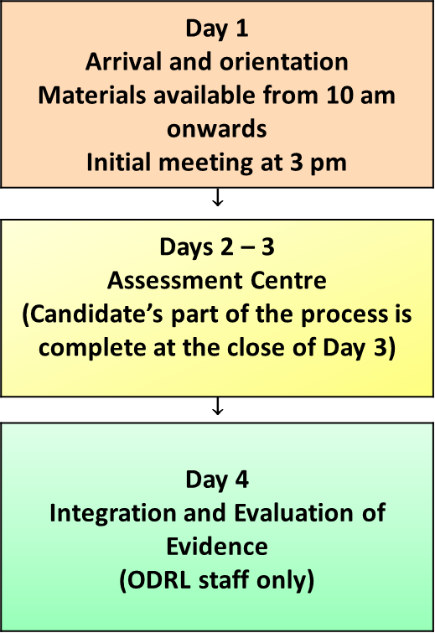
During the Assessment Centre (On-site)

Slide 11
Days 2 and 3
Examples of Exercises
  One-to-One and Group Role Play Exercises
  Group Discussion
  Presentation
  Interviews
  Written Exercises/Responses

Slide 12
Exercises and Competencies (Examples)
Group Role Plays
  Advocacy and Influence
  Resilience
  Principles, Values and Ethics
  Analysis and Decision-Making
  Drive for Results & Accountability
  Engaging & Nurturing Partners/Stakeholders
One-to-One Role Plays
  Advocacy and Influence
  Analysis and Decision-Making
  Strategic & Political Thinking
  Planning & Organising

Slide 13
Post Assessment Centre
Integration
  Assessors to collate data
  Agree overall ratings per competency per candidate
  Evaluate candidates
Follow-Up
  Prepare individual assessment reports
  Virtual feedback to candidates

Slide 14
Experience of the Assessment Centre
Impressed with the material and assessment of competencies, specially how the competencies were spread throughout the course of the assessment
Well put together; process is inter-linked woven with the crisis situations
Well organised – detailed – no wasted moment; everything went to time – well-resourced
Quality of actors good – real situation, they were able to get into the role
You come with anxieties – the atmosphere was calming
Background materials robust and reflective of the reality; design of the activities and time table - remarkable
Appreciated the professionalism and expertise demonstrated during assessment by the Centre Management Team and the Assessors

Slide 15
Experience of the Assessment Centre
Pressure is good – close to reality
Challenged me to dig deeper and reflect more constructively on my strengths and weaknesses as revealed through the RCAC assessment
Positive step for my professional development – chance to engage with areas beyond current mandate
Exceptional self-learning experience
Empowered me to briefly disengage with my Agency and think outside of the box … looking through a different lens…
Well put together; process is inter-linked woven with the crisis situations; balance between the short-term and long-terms issues about right
Provided me with very insightful observations about my competencies and offered very helpful suggestions for further development

Slide 16
Food for Thought…..
UNDP should not send quantity of reading material - this is overwhelming
Need to use computer for the written briefings
For those of us who do not have development experience – it is hard for us
All agencies should provide coaching
Need more focus on donor relations, coaching and staff development
Crisis & Human Rights issues could be difficult to react to if you’ve not had prior exposure
Are tests used for triangulation? Could be more explicit

Slide 17
Our Gender Journey
We have struggled to get sufficient women nominated across agencies for assessment
Our solution was to prioritize a “women only” assessment and those with language skills we were light on ( Arabic for example)

Slide 18
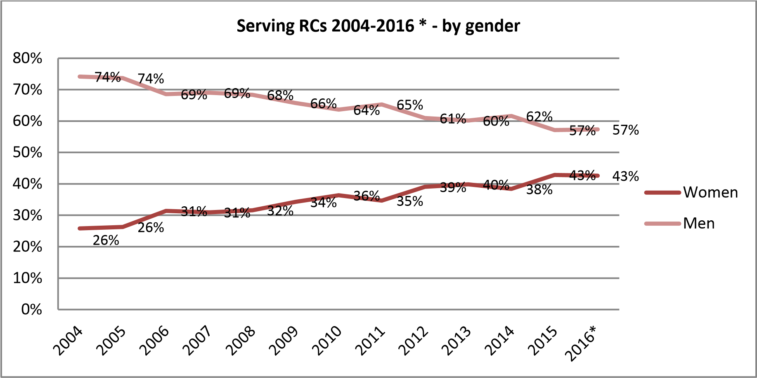
Our Gender Journey
* As of 14 November 2016

Slide 19
Our Gender & Diversity Journey
Candidates by North /South and Gender
 | North |  | South |  | Total – 3 Years
Year | Male | Female | Male | Female | Male | Female | M+F
2014 | 20 (40%) | 4 (8%) | 13 (26%) | 13 (26%) | 33 (66%) | 17 (34%) | 50
2015 | 6 (14%) | 14 (33%) | 12 (29%) | 10 (24%) | 18 (43%) | 24 (57%) | 42
2016 | 13 (21%) | 18 (29%) | 15(24%) | 16 (26%) | 28 (45%) | 34 (55%) | 62
Total | 39 (25%) | 36 (23%) | 40(26%) | 39(25%) | 79(51%) | 75 (49%) | 154

Slide 20
Candidates by North/South and Gender

Slide 21
Candidates by Gender: Cumulative 2014 - 2016
(n=154)

Slide 22
Candidates by North/South: Cumulative 2014 - 2016
(n=154)

Slide 23
Candidates by Gender – 2014 to 2016
2014 (n=50)
2015 (n=42)
2016 (n=62)

Slide 24
Candidates by North vs South – 2014 to 2016
2014 (n=50)
2015 (n=42)
2016 (n=62)

Slide 25
Recommended Candidates Over 3 Years:
North/South vs. Gender
 | MALE | FEMALE
NORTH | 62% | 78%
SOUTH | 50% | 56%

Slide 26
Recommended - Gender vs. North/South
 | Male |  |  | Female
 | Recommended |  | Not Recommended | Recommended | Not Recommended
North | 2014 | 11/20 = 55% | 9/20 = 45% | 2/4 = 50% | 2/4 = 50%
 | 2015 | 5/6 = 83% | 1/6 = 17% | 13/14 = 93% | 1/14 = 7%
 | 2016 | 8/13 = 62% | 5/13 = 38% | 13/18 = 72% | 5/18 = 28%
 | Total | 24/39 (= 62%) | 15/39 (= 38%) | 28/36 (= 78%) | 8/36 (= 22%)
South | 2014 | 3/13 = 23% | 10/13 = 77% | 7/13 = 54% | 6/13 = 46%
 | 2015 | 8/12 = 67% | 4/12 = 33% | 4/10 = 40% | 6/10 = 60%
 | 2016 | 9/15 = 60% | 6/15 = 40% | 11/16 = 69% | 5/16 = 31%
 | Total | 20/40 (= 50%) | 20/40 (= 50%) | 22/39 (= 56%) | 17/39 (= 44%)

Slide 27
Do Assessment Centres Increase Accuracy of Selection Decisions?
Research findings indicate:
  Assessment Centres yield the highest validity scores (a correlation score of 0.7) when compared to other selection techniques providing the methodology is applied rigorously and appropriately.
Points to Consider
  Content Validity: Concerned with ensuring that the exercise content reflects the demands, context and complexity of the target role as accurately as possible.
  Construct Validity: Explores the extent to which criteria/ competencies being measured are discrete variables and relate to the target job.
  Predictive Validity Studies: Performance of candidates can be tracked over time through identifying career progression, appraisal ratings, 360 evaluations, self-evaluation and other similar measures
  Updating Exercises: Parallel forms of exercises help to maintain validity of outcomes
2

Slide 28
Using Candidate Pools for Assignment
We assess more candidates than we have positions and we have three pools:
Pool A – those assessed who could be deployed immediately (55 people)
Pool B – those serving on other assignments (115 people)
Pool C – serving RC’s (122 people)
We want to have pre-assessed candidates ready to assign:
  Government clearance can take time
  We need to take account of nationality, languages, and the diversity of roles (humanitarian, crisis, fragile states, middle income etc)
2

Slide 29
And Keeping a Focus on North/South
Serving RCs 2004
-
2016
*
-
by geography
70
%
60
%
56
%
57
%
57
%
54
%
55
%
50
%
50
%
55
%
54
%
56
%
50
%
50
%
50
%
52
%
52
%
51
%
46
%
48
%
48
%
49
%
46
%
45
%
44
%
45
%
43
%
44
%
43
%
40
%
North
30
%
South
20
%
10
%
0
%
2004
2005
2006
2007
2008
2009
2010
2011
2012
2013
2014
2015
2016*

Slide 30
National Diversity of Serving RC’s
Region of Origin
50
43
40
30
Resident Coordinators
22
22
20
13
10
10
6
4
2
0
Africa
Arab States
Asia and
Eastern
Latin
Oceania
North
West
Pacific
Europe and
America
America
Europe
CIS

Slide 31
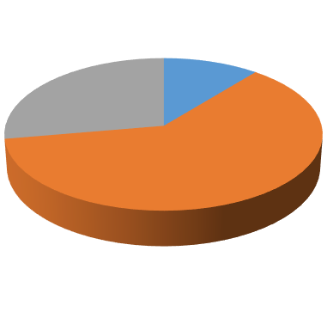
And Language Skills
RC jobs: Grade Level
Serving RC’s
Language Skills
Por
8
ASG
11
%
Arab
6
D2
Language
Rus
4
28
%
D1
Spa
35
61
%
Fre
5
2
Eng
0
20
40
60
80
100
Number (blue) and % (orange)

Slide 32
Planning Ahead for RC’s into the Future and Ensuring Supply
Pool C: Number of Candidates to Retire
60
57
55
50
48
45
40
35
Candidates
30
25
20
15
10
10
7
5
0
1
year
2
to
5
6
to
10
11
to
20
Years before retirement

Slide 33
Our journey to increase agency participation
Serving RCs 2004
-
2016
*
-
by agency
80
%
73
%
75
%
70
%
71
%
72
%
69
%
68
%
64
%
65
%
60
%
61
%
59
%
58
%
55
%
56
%
50
%
45
%
44
%
42
%
40
%
39
%
41
%
Non-UNDP
32
%
36
%
35
%
UNDP
30
%
29
%
28
%
31
%
28
%
25
%
20
%
10
%
0
%
2004
2005
2006
2007
2008
2009
2010
2011
2012
2013
2014
2015
2016*

Slide 34
Analysis of Assessments & Performance
In 2016, we reviewed and analyzed the Candidate Pool Programme’s effectiveness as a tool to objectively attract, assess and select candidates for leadership positions.
Trends
Which are the strongest and weakest competencies?
Are there yearly differences between rankings?
Do Performance Appraisal results consistently differ from Assessment Center results?
Correlations
Do high-scoring candidates also perform better?
What about low scoring candidates?
Additional Information
Are bottom performers in low or high performing offices?
Are high performers in high or low performing offices?

Slide 35
Sample Overview
Total Sample
Assessment Centre Results, scale: 1 – 4
Sample | Number
Total | 172
Assessment Centre Ratings (2013 – 2016) | 172
Performance Appraisals (2013 – 2016) | 166
Category | Range | PA results
Ready (32 %) | 2.8 – 4 | 3.1 – 4.8
Ready with Development (14 %) | 2.8 – 3.2 | 2.6 – 5
Not Ready (54 %) | 1.8 – 3.4 | 2.4 – 4.8
Top 20% | 3.4 – 4
Bottom 20% | 1.8 – 2.2
Performance Appraisal Results, scale: 1 – 5
The analysis reviewed all candidates from 2013-2016. The study was conducted in 2016; therefore, not all 2016 Performance Appraisals were available yet.
Category | Range
Total range | 2.4 – 5
Top 20% | 4.5 – 5
Bottom 20% | 2.4 – 3.5
Notes:
The Candidate Pool Program currently includes 179 candidates that have been assessed. The two charts on the left illustrate the existing ranges in AC and PA results (1 = low).
Now I am going to take you through these questions, but because I don’t want to bore you, I will try and focus directly on our findings and highlight the important results. Bare with me!

Slide 36
Assessment Centre Results (2013-2016)
On average, 31% of candidates passed the CD/DRR/DCD Assessment Centres.
 | 2013 | 2014 | 2015 | 2016
Candidates per year | 52 | 74 | 23 | 23
% of entire Candidate pool (172) | 30% | 44% | 13% | 13%
Ready | 16 (30%) | 25 (34%) | 8 (34%) | 6 (26%)
Ready w Development | 10 (20%) | 11 (15%) | 5 (22%) | -
Not Ready | 26 (50%) | 38 (51%) | 10 (44%) | 17 (74%)
Average rating | 2.75 | 2.9 | 3.15 | 2.92
In relation to overall average rating (2.89) | lower | higher | higher | higher
2013
2014
2015
2016
Overall average rating: 2.89
Notes:
The following chart aims at showing how many people participate in the Assessment Center per year. It also shows how each year (“cohort”) performs in relation to the overall performance of all four years together.
Each year, roughly the same amount of people pass, kind of pass and don’t pass the AC. This suggests that there is consistency in how many candidates are admitted to the Pool.
What stands out is last year, where more than 70% of candidates didn’t pass.
Insights
2015 was the year with the highest AC average
Most people failed in 2016

Slide 37
The annual differences in Performance Appraisals are minimal.
Performance Appraisals (2013-2016)
 | 2013 | 2014 | 2015 | 2016
Candidates per year | 50 | 70 | 23 | 23
% of entire Candidate pool (172) | 30 % | 41 % | 14.5 % | 14.5 %
5* | 6 (12%) | 9 (13%) | 3 (13%) | 4 (17%)
4 | 36 (72%) | 56 (80%) | 17 (74%) | 18 (78%)
3 | 7 (14%) | 5 (7%) | 3 (13%) | 1 (5%)
2 | - | - | - | -
1 | - | - | - | -
AV | 3.8 | 4 | 4 | 3.9
In relation to AV Overall (3.9) | lower | Higher | Higher | equal
Performance rating averages per year
2013
2014
2015
2016
Overall average rating: 3.9
* Each rank includes the range from .5 to .4
Notes:
The following chart aims at showing how many pool candidates have Performance Appraisal data available per year. It also shows how each year (“cohort”) performs in relation to the overall performance of all four years together.
This result suggests that each “cohort” has similar results: each year, on average, country directors and deputy country directors perform similiarly
Insights
the majority is ranked 4
no one is ranked 1 or 2

Slide 38
Assessment & Performance Trends
Communication and Delivery are the top-rated competencies respectively, while Innovation is the low-rated competency in Assessment Centres and Performance Appraisals.
Assessment Centre (scale 1-4)
Performance Appraisals (scale 1-5)
Ranking | Competency | Score | %
1 | Communication | 2.97 | 74.25
2 | People Management | 2.93 | 73.25
3 | Delivery | 2.9 | 72.5
4 | Leadership | 2.89 | 72.25
5 | Innovation | 2.77 | 69.25
Ranking | Competency | Score | %
1 | Delivery | 4.14 | 82.8
2 | Leadership | 4.04 | 80.8
3 | Communication | 4.03 | 80.6
4 | People Management | 3.98 | 79.6
5 | Innovation | 3.84 | 76.8
Notes:
This question aims at understanding which competencies candidates perform best and worst in, over the course of four years.

Slide 39
On average, Performance ratings are 7.8% higher than Assessment ratings.
Assessment & Performance Trends
Assessment Center (scale 1-4)
Performance Appraisals (scale 1-5)
Ranking | Competency | Score | %
1 | Communication | 2.97 | 74.25
2 | People Management | 2.93 | 73.25
3 | Delivery | 2.9 | 72.5
4 | Leadership | 2.89 | 72.25
5 | Innovation | 2.77 | 69.25
Ranking | Competency | Score | %
1 | Delivery | 4.14 | 82.8
2 | Leadership | 4.04 | 80.8
3 | Communication | 4.03 | 80.6
4 | People Management | 3.98 | 79.6
5 | Innovation | 3.84 | 76.8
CORRELATION
The correlation between those rated 3 or 4 in the Assessment Centre with those rated 4 or 5 in Performance Appraisals (N=192): 55%
Notes:
This question aims at comparing the outcomes of performance appraisals and assessment centers, to see if one has higher or lower outcomes than the other.
Looking at relative results (score percentage of the respective scale), performance appraisal results are, on average, 7.8% higher than assessment center results
Suggesting that country directors or deputy country directors get higher ratings when they are assessed by their supervisors rather than by people they don’t work directly with.

Slide 40
Audit ratings are consistent with Performance and Assessment results.
Additional Information
Audit Rating and Performance-Assessment Results
Audit Rating | # Countries | Candidates with top PA/AC | Candidates with middle PA/AC | Candidates with bottom PA/AC
Satisfactory | 13 | 9 (3 during) | 3 | 1 (during)
Partially Satisfactory | 17 | 5 (4 during) | 4 (during) | 8 (4 during)
Unsatisfactory | 2 | - | 1 (after) | 1 (after)
The table above shows how many of the Country Directors in charge during or after the review period (2013-2016) had top, middle or bottom performance and/or assessment ratings
Notes:
The 32 countries for this analysis were selected on the basis of two criteria
Country Directors (no DCD-DRR)
Top and bottom 20% of Performance Appraisals and Assessment Centers
The table above shows how many of the Country Directors in charge during or after the review period examined in the audit had top, middle or bottom performance or assessment ratings
This suggests that there is consistency between Audit and Performance-Assessment center ratings.
Insights
The vast majority of Country Directors in offices with satisfactory audit reports are have high AC or PA results
In the partially satisfactory ranking offices, Country Directors have high, middle or low rankings

Slide 41
Internal Study: Trends & Conclusions
The analysis yields the following main insights:
Trends
Performance Appraisals have consistently higher ratings than Assessment Centre results.
Innovation is the lowest ranking competency in Performance and Assessment results. People Management is the second lowest Performance Appraisal competency.
Except for Communication, Assessment Centre results vary from year to year, suggesting differences in competencies of candidates who take part in the AC.
Correlations and Additional Information
There is a relationship between performance and assessment ratings as well as overall audit ratings. This suggests that the program is effective.
The consistency of ‘Ready’ ratings and correlations found in high performing offices with top performing Country Directors, supports the discontinuation of the result ‘Ready with Development’ in 2016.
However, in order to establish a causal relationship, data from the engagement surveys and program deliveries must be added and analyzed.
Notes:
Additional Insights
Within the range of 2.8 and 3.4, candidates have been assessed both ready or not ready, due to the Assessment Center methodology and weighting of exercises.
54% of candidates don’t pass the assessment center

Slide 42
Summary
Assessing potential talent for the UN’s and UNDP’s most important leadership roles through robust and demanding methods with a high validity.
Candidate Pools – applying fair selection principles valuing service and performance.
Working towards gender and diversity targets at all levels.
Consistently reviewing and developing our programmes to offer best and next practice.
Notes:
Additional Insights
Within the range of 2.8 and 3.4, candidates have been assessed both ready or not ready, due to the Assessment Center methodology and weighting of exercises.
54% of candidates don’t pass the assessment center

Slide 43

Empowered lives. Resilient nations.
Thank You
Спасибо
谢谢
Gracias
Merci
ﺷﻜﺮﺍﹰ

